Slide 1
In-Depth Analysis of Thermometer Encoding Defense against Adversarial Example Attack
Michael Haven, Adnan Siraj Rakin, Glen Uehara
EEE 511 Team 2

Slide 2
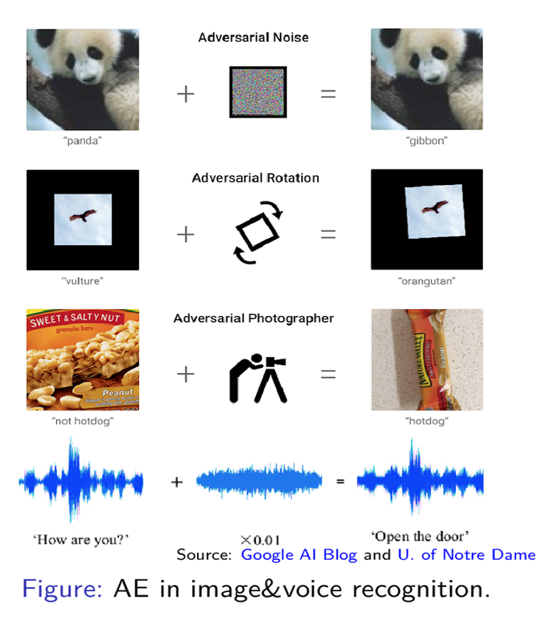
What is Adversarial Attack?
Adversarial attacks are known as slight perturbation of input samples to completely fool a Deep Learning/Machine Learning model.

Slide 3
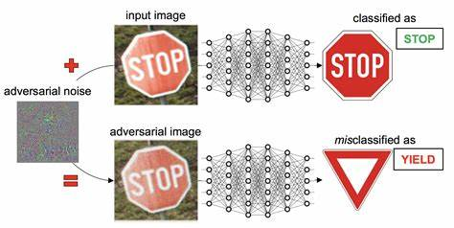
Real Life Example of AE
Source: https://pluribus-one.it/images/2018/04/14/adv-stop.png

Slide 4
Types of Attacks
Two types of method for adversarial example attack primarily: White-box and Black-box Attack.
Popular White-Box Attack:
Fast Gradient Sign Method (FGSM)
Projected Gradient Descent (PGD/LS-PGA)

Slide 5
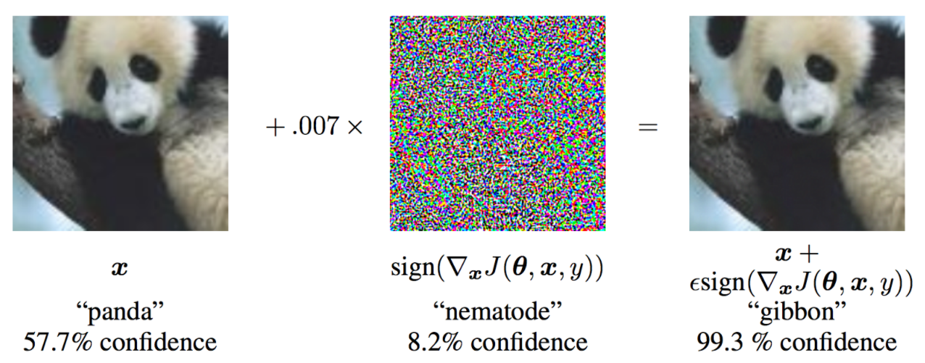
Example of FGSM Attack

Slide 6
How to Defend them?
There are two primary approaches to defending a system:
Adversarial Training.
Randomization during inference.

Slide 7
Our Investigation
2018 ICLR Defense paper:
Thermometer Encoding (Buckman et. al) (Google)
2018 ICML Attack paper:
Obfuscated gradient (Anish et. al) (Google)

Slide 8
Project Overview:
Build Encoded Model
Validate Model on Standard Data
Apply on Our Dataset
Discuss Weakness
Notes:
Build an AI model protected by Thermometer Encoding
Test it on standard dataset from the paper.
Build our own dataset and apply the defense.
Finally, Discuss the attack paper that can break this defense and how that applies.

Slide 9
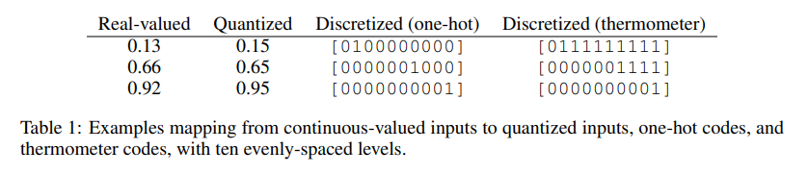
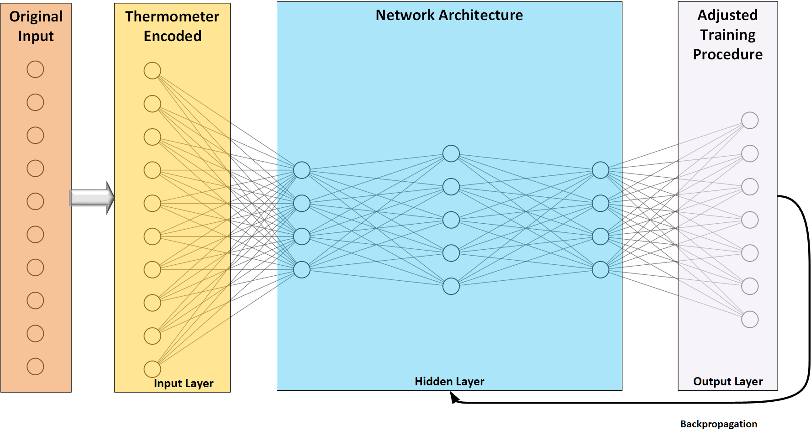
Thermometer Encoding
Thermometer Encoding is applied to the input pixels and during training the model is trained on encoded input values.
Notes:
The research by Buckman shows that one defense against adversarial attacks is to discretize the input in a method using thermometer encoding. Thermometer encoding is like one-hot encoding, but it represents magnitude instead of a categorical variable. So for example, if you need to represent a magnitude of 7 in a vector of 10 elements, then the thermometer encoding will be [0,0,0,1,1,1,1,1,1,1]. In short, its an alternative way to encode magnitude. We basically trail with “1”.
As you can see in the diagram, we will take our original input (image) and encode them. This is then used as our input (in our input layer) into our DNN. We used this new input to train our system.

Slide 10
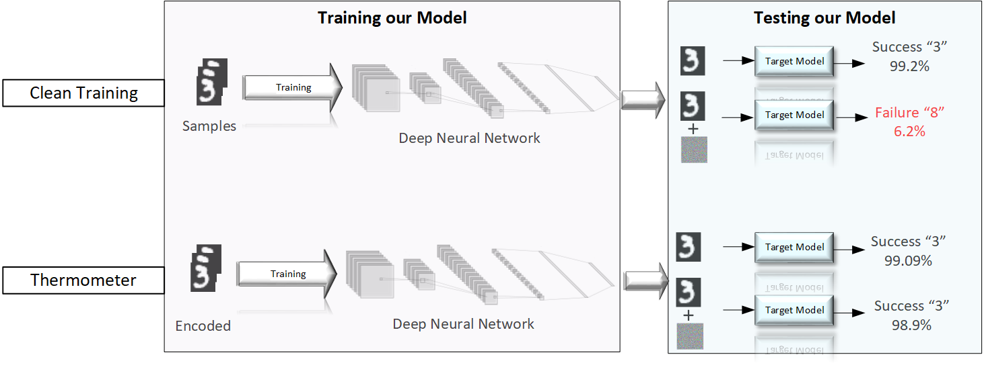
Building our Model
Below is an example of MNIST experiment
Notes:
Here we will quickly review how we build, train and test our models. We begin with our clean examples, before the encoding. We start training with our handwritten characters and train our target model. We then test, as you can see our clean data shows a successful categorization. We then add an attack and we can see that this quickly fails to an accuracy of 6.2%. We next use thermometer encoded data and train our model. Again we perform similar tests. This time, when we attack the image, we can get an accuracy of 98.9%.

Slide 11
Results
Summary of result for thermometer encoding on ResNet-18 (CIFAR-10) and LeNet (MNIST) model. The result is within∼0.5 % of the result in [1]
Model | Type | Clean Accuracy (%) | Accuracy Under Attack (%)
CIFAR-10 | Clean Training | 95.2 | 4.0
 | Thermometer (TE) [1] | 92.77 | 54.48
 | Adv. Training + TE [1] | 90.48 | 79.09
MNIST | Clean Training | 99.32 | 6.4
 | Thermometer (TE) [1] | 99.09 | 98.9
 | Adv. Training + TE [1] | 98.74 | 98.96
Notes:
Here is our results from the rest of our model development. We begin by going through the different types. We start with Clean Training, we then use Thermometer encoded data, and finally, we use an Adversarial training with thermometer encoding. Looking at the results for CIFAR-10, we can see that in the case of clean training, our results are low (4.0%). We then look at only a thermometer encoded input, we are better at 54.48%. FInally, we can see that when we use adversarial training and thermometer encoding, we get to 79.09% accuracy.

Slide 12
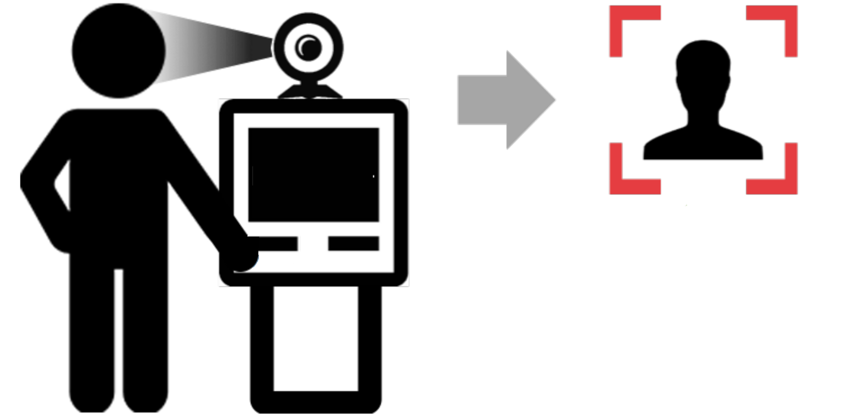
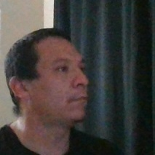

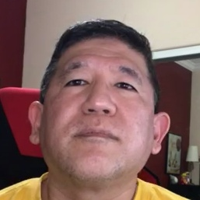



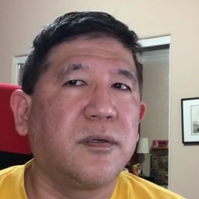


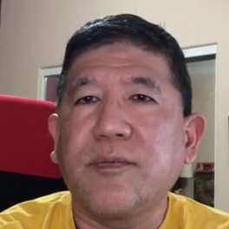
Building our Dataset
How we capture the data
Each of us collected self
portrait images
Program: face-recognition.py
https://github.com/opencv/opencv
Notes:
Modified Haar Cascades Facial Recognition to collect dataset

Slide 13
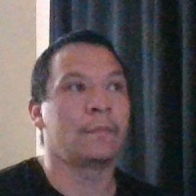

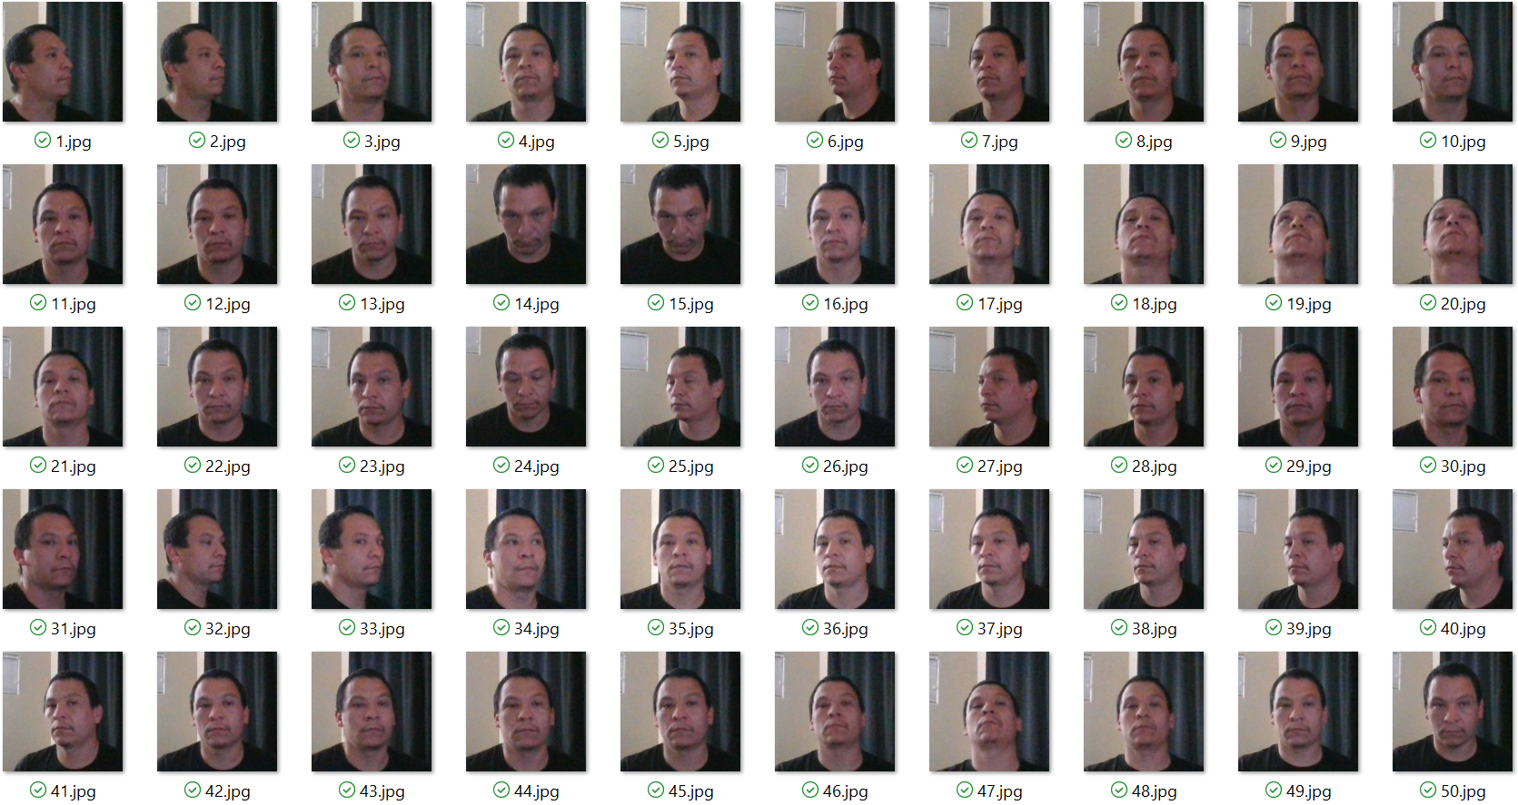
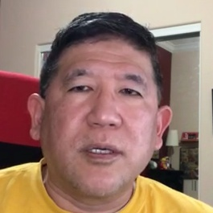
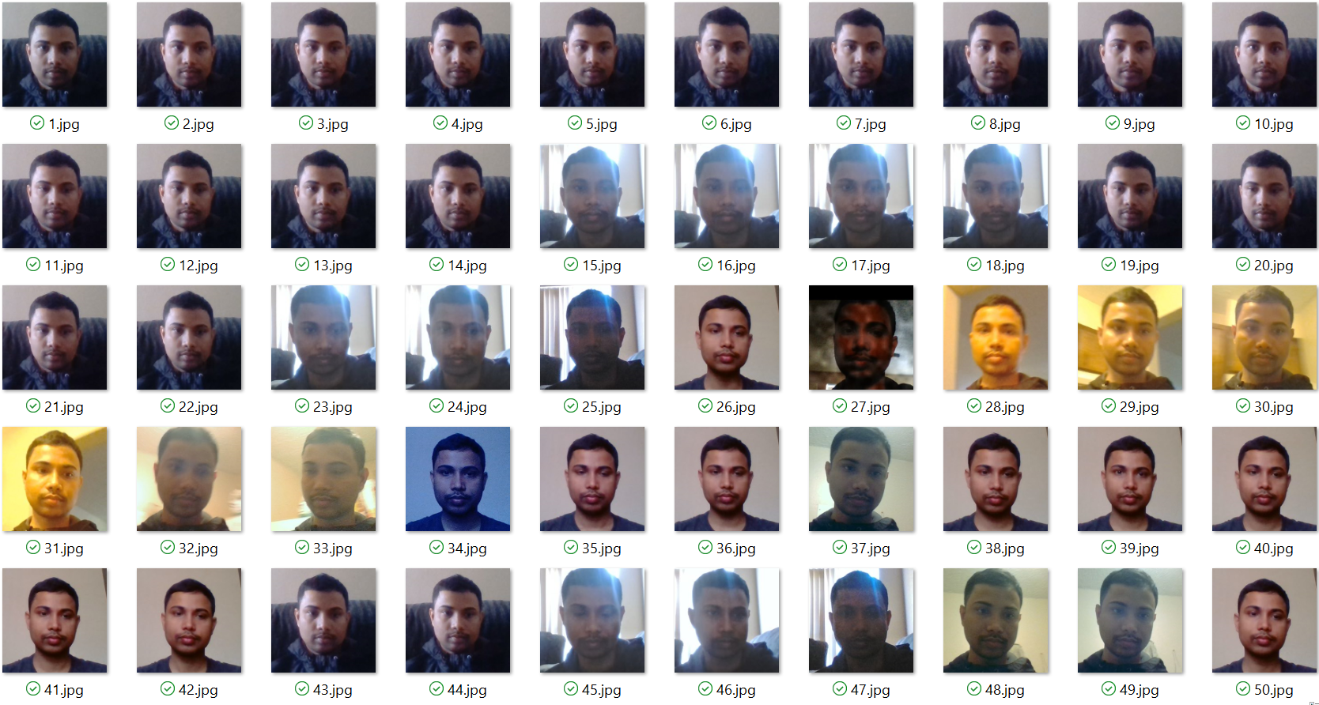
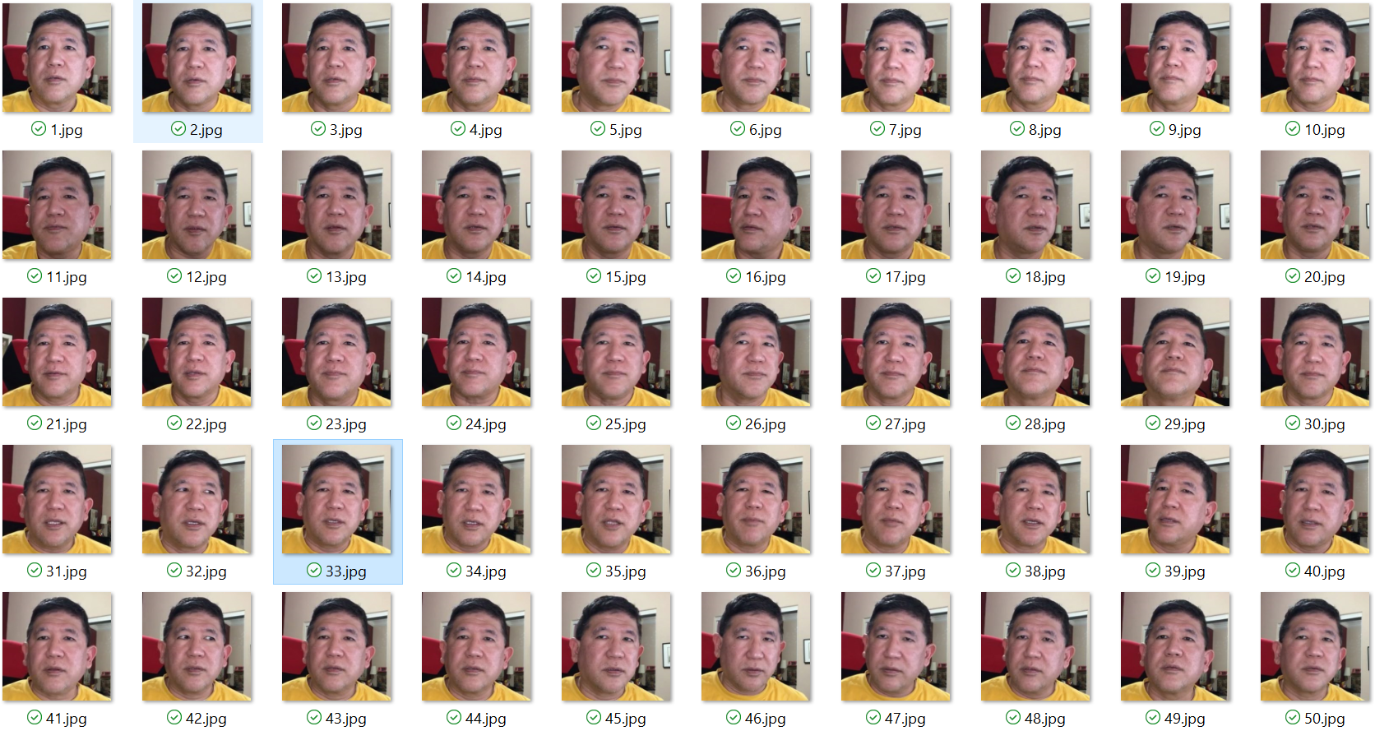
Example of our Dataset
Notes:
Applied Filters and normalization;
This is a collection of self-portrait images. We added some filters, different facial pose, etc. We are working to create normalization of our image set

Slide 14
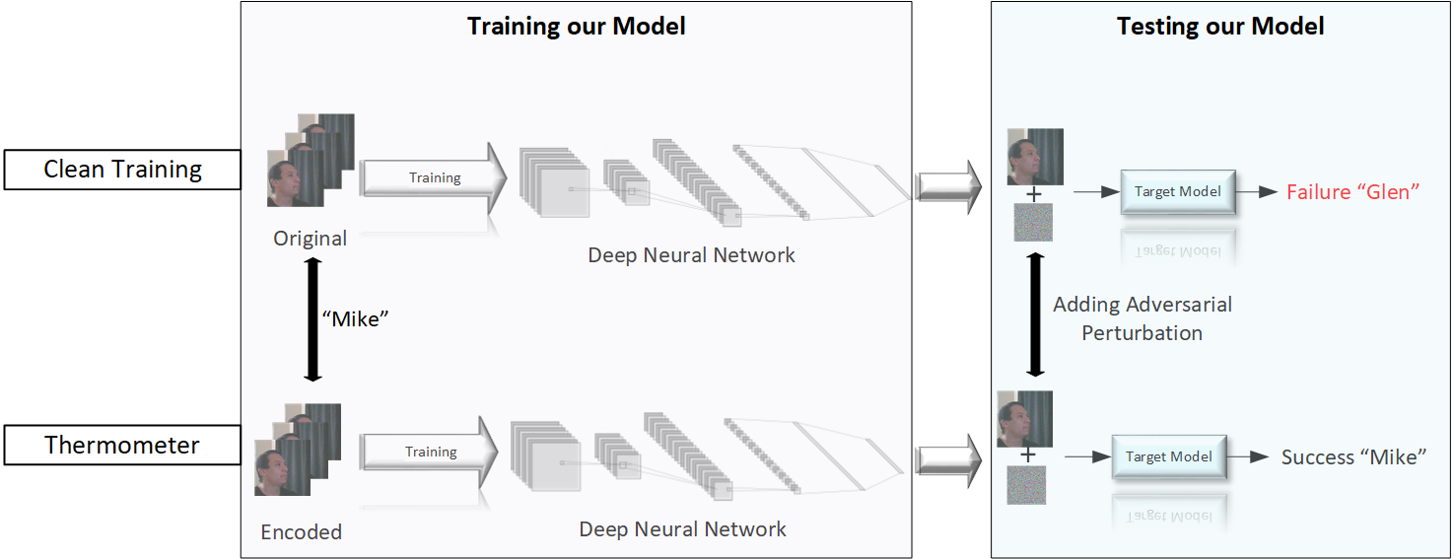
Simulation with our Dataset
Notes:
Original Image goes into training step of our model,
the clean model

Slide 15
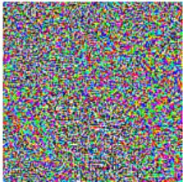
Results with our Dataset
Before Encoding:
+
=
Mike
Glen
After Encoding
+
=
Mike
Mike
Notes:
Before encoding, adversarial noise, Imperticible noise added

Slide 16
Results with our Dataset:
Summary of result for simulation with self-portrait image
Type | Accuracy under Attack
Clean Training | 46.67
Thermometer(TE) [1] | 100.0
Notes:
Summary of our results, with clean training 46% after encoding 100%

Slide 17
Why Thermometer Encoding works?
Answer: It does not work actually.
It gives a false sense of security concluded by
[1802.00420] Obfuscated Gradients Give a False Sense of Security: Circumventing Defenses to Adversarial Examples (arxiv.org)(ICML 2018)

Slide 18
What is obfuscated gradient?
We tested the checklist of obfuscated gradient:
Attack Strength has no effect on defense.
Attack Step has no effect on defense.
White-box PGD accuracy does not go to 0 % given enough attack strength.

Slide 19
Conclusion
We presented two hypothesis from two different research paper.
We validated that using experimental evaluation on standard dataset.
Finally, we apply that on our toy dataset as well to establish both the hypothesis.

Slide 20
References
[1] C. R. I. G. Jacob Buckman, Aurko Roy, “Thermometer encoding: One hot way to resist adversarial examples,”International Conference on Learning Representations, 2018, accepted as poster. [Online]. Available: https://openreview.net/forum?id=S18Su--CW
[2]A. Athalye, N. Carlini, and D. Wagner, “Obfuscated gradients give a false sense of security: Circumventing defenses to adversarial examples,”arXiv preprint arXiv:1802.00420, 2018.
[3]I. J. Goodfellow, J. Shlens, and C. Szegedy, “Explaining and harnessing adversarial examples,”ICLR, 2015.
[4]A. Madry, A. Makelov, L. Schmidt, D. Tsipras, and A. Vladu,“Towards deep learning models resistant to adversarial attacks,”arXiv preprint arXiv:1706.06083, 2017.
[5]L. Deng, “The mnist database of handwritten digit images for machine learning research [best of the web],”IEEE Signal Processing Magazine, vol. 29, no. 6, pp. 141–142, 2012.
[6]A. Krizhevsky and G. Hinton, “Convolutional deep belief networks on cifar-10,”Unpublished manuscript, vol. 40, no. 7, pp. 1–9,2010.
[7]A. Athalye and N. Carlini, “On the robustness of the cvpr 2018 white-box adversarial example defenses,”arXiv preprint arXiv:1804.03286, 2018.
[8]K. He, X. Zhang, S. Ren, and J. Sun, “Deep residual learning for image recognition,” inProceedings of the IEEE conference on computer vision and pattern recognition, 2016, pp. 770–778.
[9]K. Simonyan and A. Zisserman, “Very deep convolutional networks for large-scale image recognition,”arXiv preprint arXiv:1409.1556, 2014.
[10] Y. LeCunet al., “Lenet-5, convolutional neural networks,” URL:http://yann. lecun. com/exdb/lenet, p. 20, 2015.
[11] C.-J. Simon-Gabriel, Y. Ollivier, L. Bottou, B. Sch ̈olkopf,and D. Lopez-Paz, “First-order adversarial vulnerability of neural networks and input dimension,” in Proceedings of the 36th International Conference on Machine Learning, ser.Proceedings of Machine Learning Research, K. Chaudhuri andR. Salakhutdinov, Eds., vol. 97.PMLR, 09–15 Jun 2019,pp. 5809–5817. [Online]. Available: http://proceedings.mlr.press/v97/simon-gabriel19a.html

Slide 21

Questions?

Slide 22
THANK YOU

